Slide 1
INTO THE UNKNOWN WILDS: FOSTERING PRODUCTIVE UNCERTAINTY IN INFORMATION LITERACY
Emilia Marcyk & Chana Kraus-Friedberg
Michigan State University
LOEX 2019

Slide 2
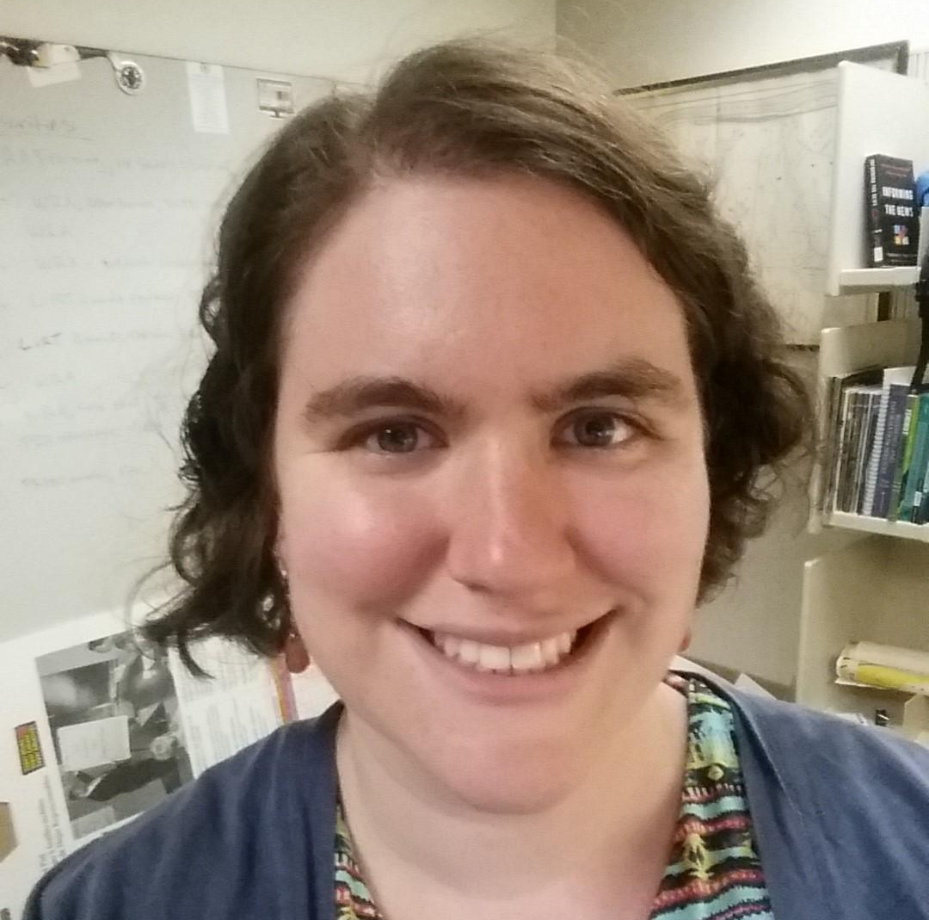
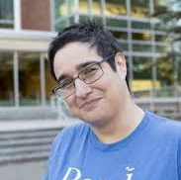
About Us
Emilia Marcyk (presenting)
Works mostly with first year students in writing classes
Often asked to teach students to find “good” or “reliable” information
Chana Kraus-Friedberg (collaborator)
Works mostly with medical students and graduate students in public health
Involved in teaching Evidence Based Medicine/finding “good” medical research
http://bit.ly/uncertainLOEX

Slide 3
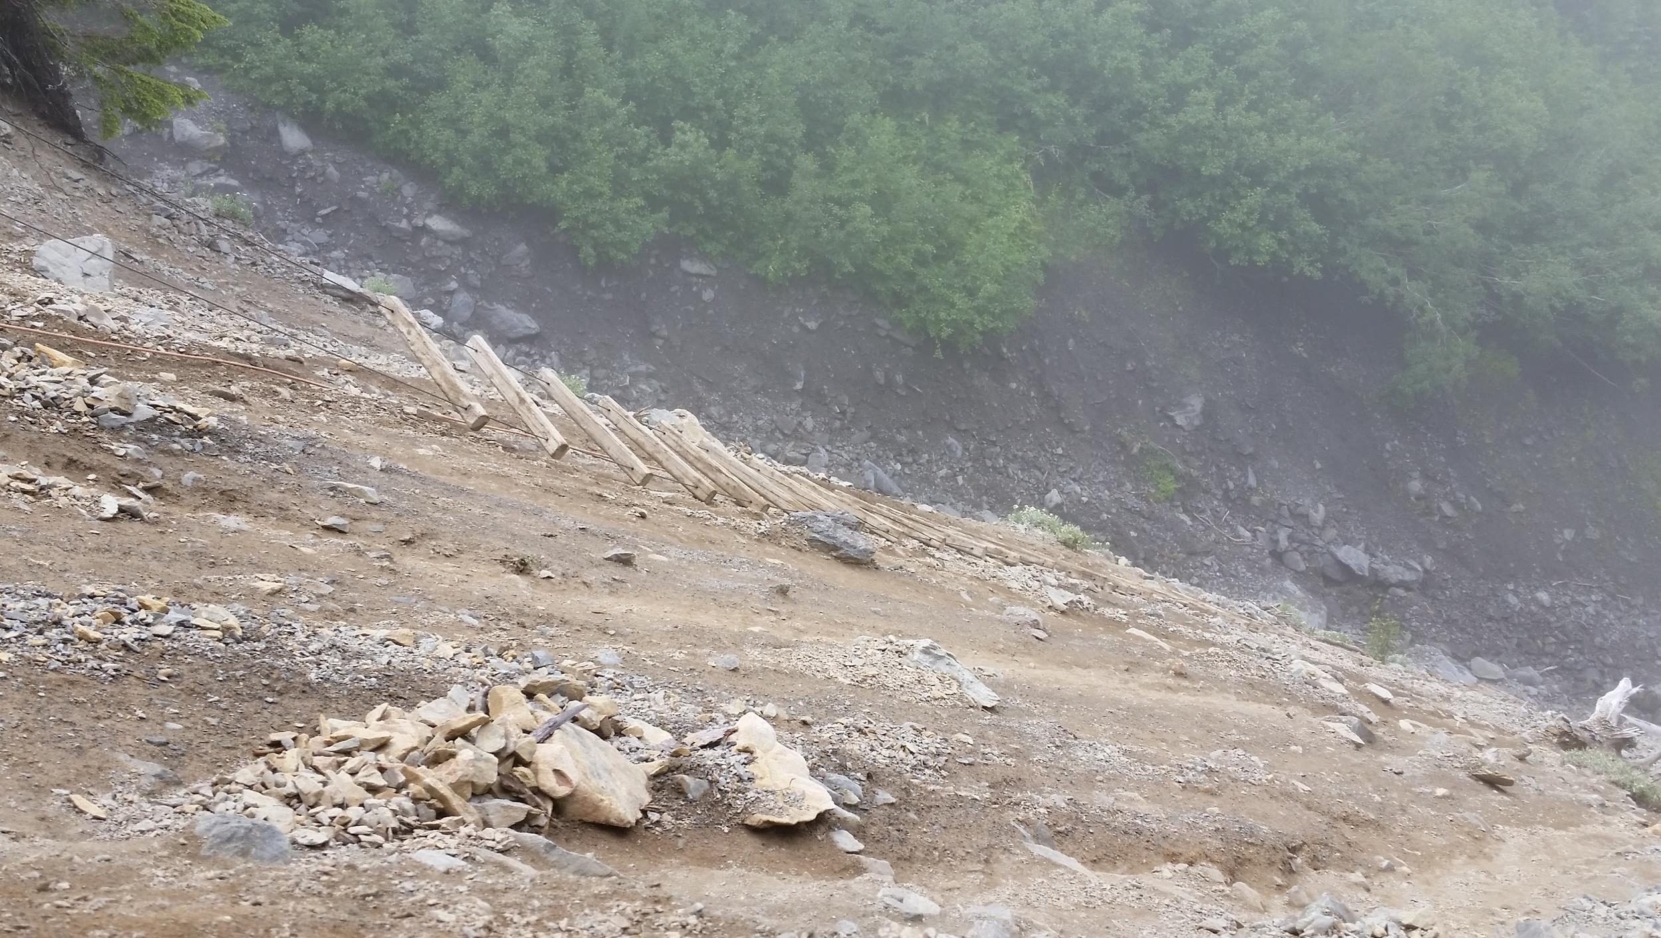
Defining Productive Uncertainty

Slide 4
Productive Uncertainty is the...
Expectation or understanding that parts of research and learning are necessarily “non-obvious and contingent” (Manz 2018)
Ability to engage with what is still unknown or uncertain, in order to acquire or create further knowledge or to make decisions

Slide 5
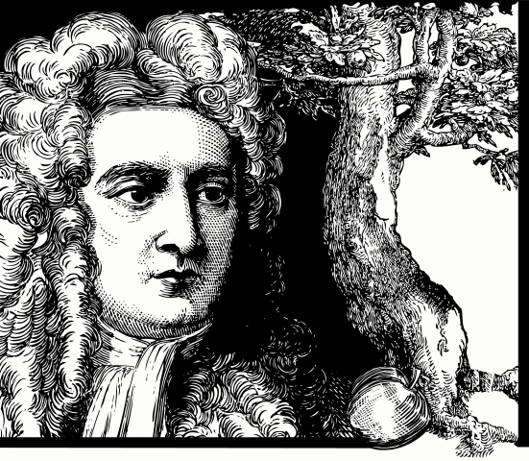
Example: Gravity

Slide 6
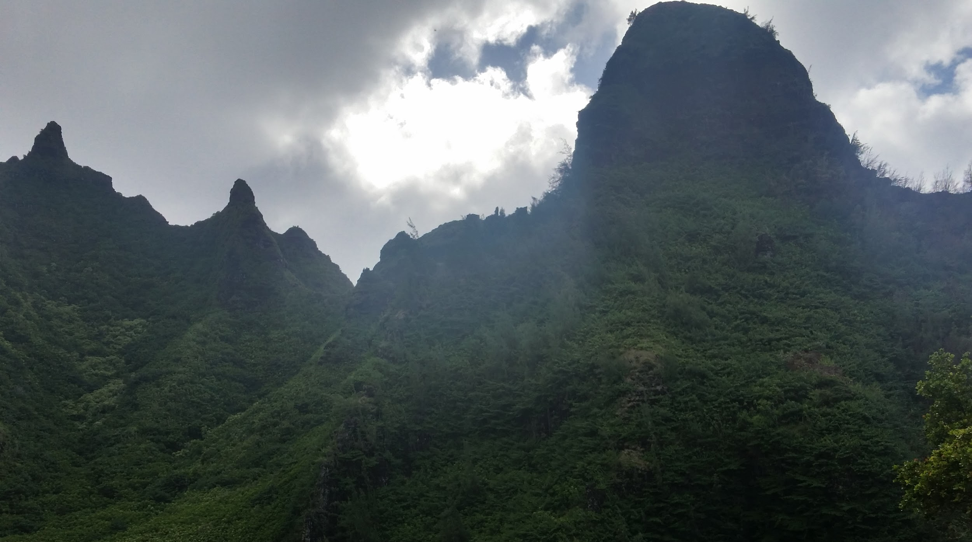
“The unknowable may itself become a fact. It can serve as a portal to deeper understanding. Most important, it certainly has not interfered with the production of ignorance and therefore of the scientific program. Rather, the very notions of incompleteness or uncertainty should be taken as the herald of science.”
- Stuart Firestein
Ignorance: How it Drives Science

Slide 7
Example: Breaking News
On the Media (2013). Breaking news consumer’s handbook. Retrieved from: https://www.wnyc.org/story/breaking-news-consumers-handbook-pdf/

Slide 8
Implications:
In the Classroom

Slide 9
Perry: Intellectual Development
Kuhn et. al: Development of Epistemological Understanding
Dualism
Multiplicity
Relativism
Commitment in Relativism
Realist
Absolutist
Multiplist
Evaluativist

Slide 10
CRAAP Test
Currency: The timeliness of the information.
Relevance: The importance of the information for your needs.
Authority: The source of the information.
Accuracy: The reliability, truthfulness and correctness of the content.
Purpose: The reason the information exists.
CRAAP Checklist from CSU Chico: http://library.csuchico.edu/help/source-or-information-good

Slide 11
Implications:
Outside the Classroom

Slide 12
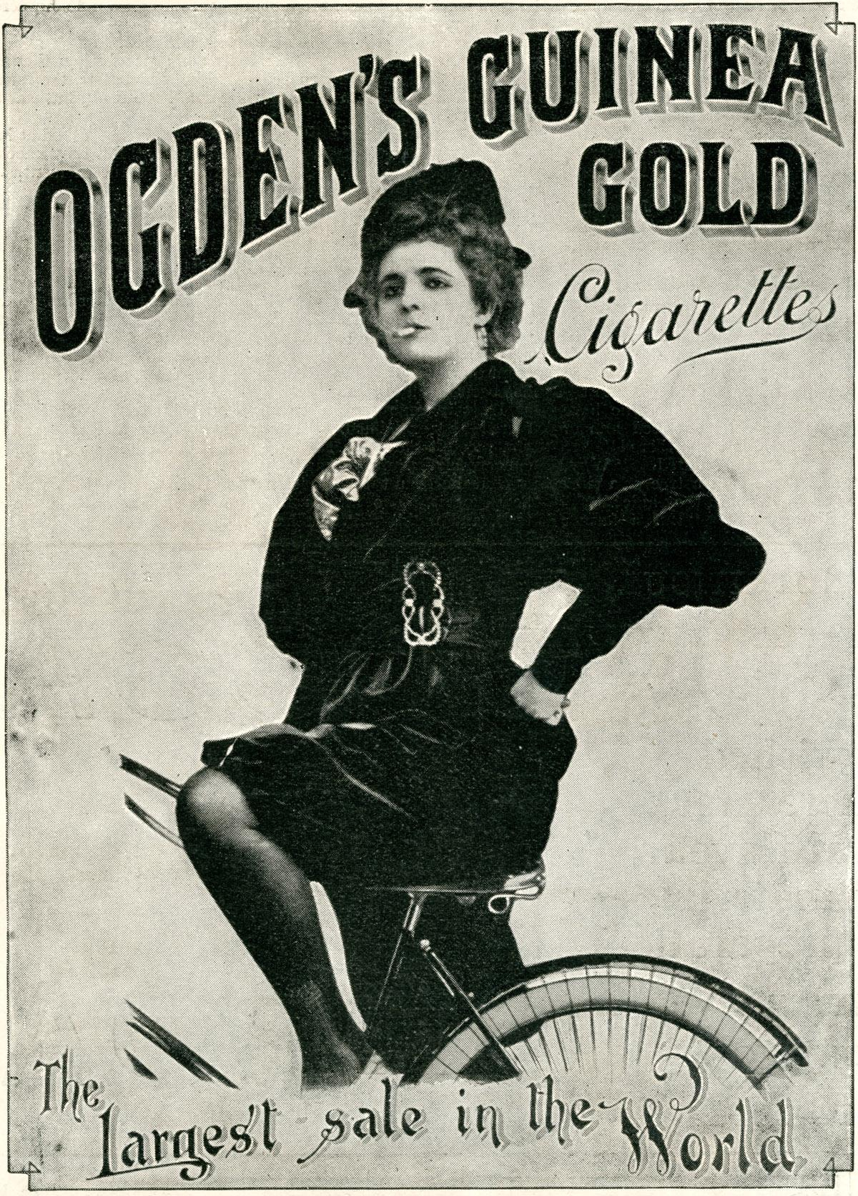
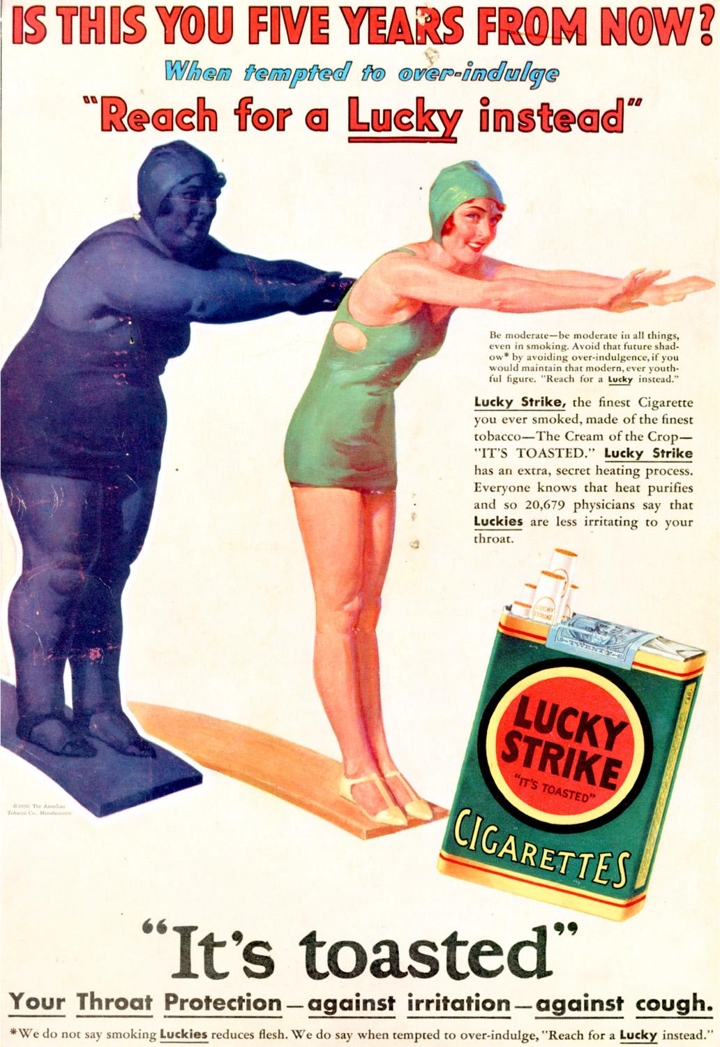

Slide 13
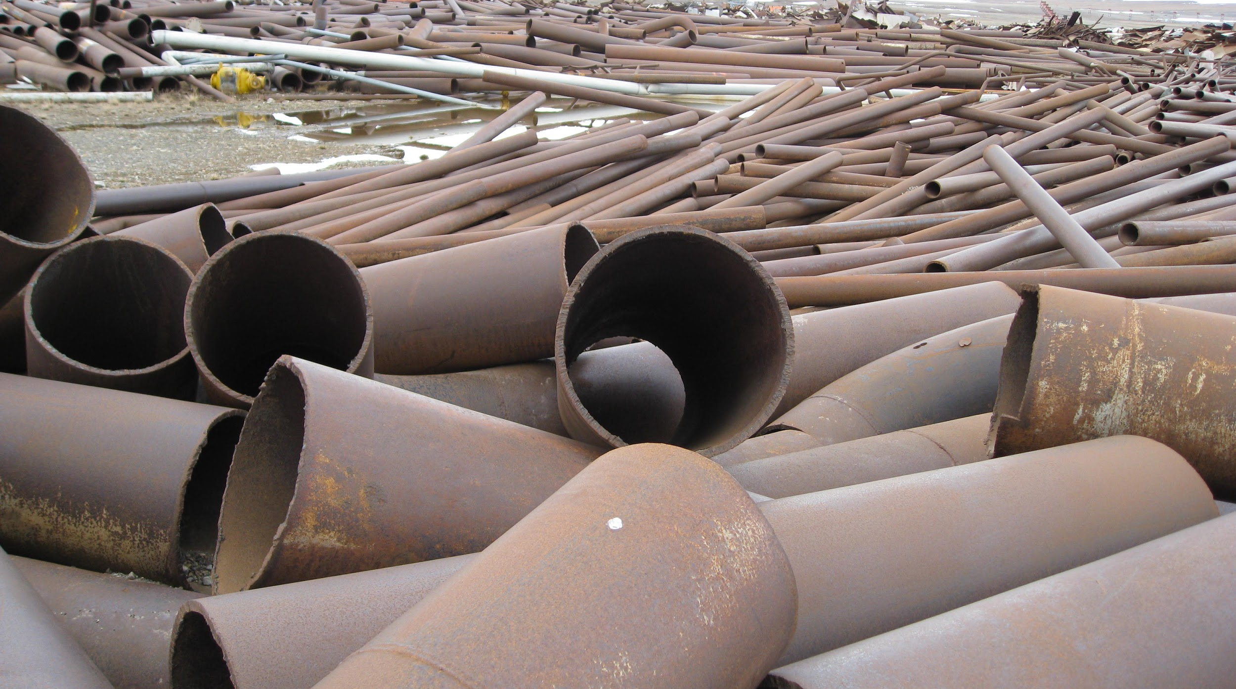
“Jenny and I had worked on dozens of academic studies over the years, but putting together an utterly perfect and unassailable one - in a matter of days, no less - was a bit of a leap. The pressure was intense. One minor error, even one that didn't affect the findings, would give critics the ammunition to undermine me. One minor error and all our efforts would be for nothing, and the Flint kids would go on being poisoned. I was already out on a limb - and already being ignored. We had to produce a study that couldn't be.”
-Dr. Mona Hanna-Attisha
What the Eyes Don't See

Slide 14
Teaching Examples

Slide 15
Video created by Emilia Marcyk: view video on MSU MediaSpace

Slide 16
Peer Reviewed Article Questions (Standard)
Who is the author of the article? Are they an expert in their field?
Does the document use straightforward or technical language? Would you describe the writing as formal, informal, or in between?
Where was the article published? Who is the audience for that publication?
What evidence does the author use to support their claims?

Slide 17
Rewritten Peer Reviewed Article Questions (with Productive Uncertainty)
What can we know and what can we not know from reading this article?
How certain/uncertain is the author about their claims? Do the data support that level of certainty?
How does the article relate to other information about the same or similar content?
Who is the author, and what is their connection to the content?
How is the publisher/journal connected to larger conversations about similar topics?

Slide 18
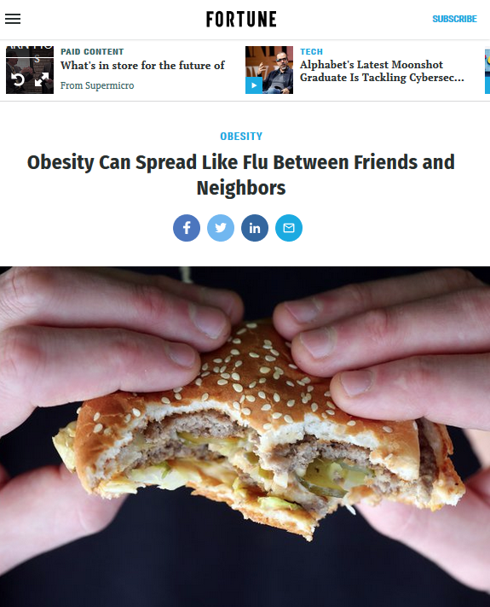
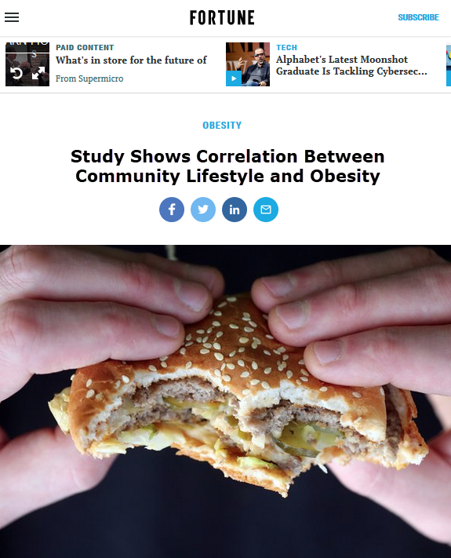
Exercise: Deflating headlines

Slide 19
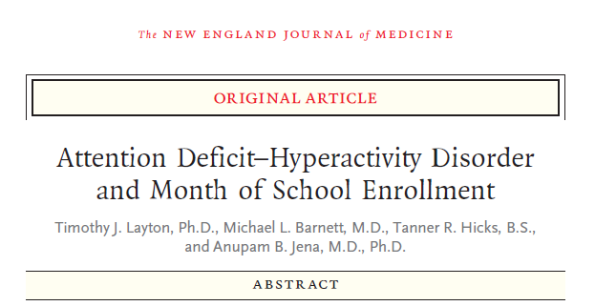
Exercise: Looking at Uncertainty in Scientific Literature

Slide 20
Uncertainty in Scientific Literature Questions
Where does the conclusion apply, and to whom?
Note that one thing the conclusion is lacking is an explanation of WHY this is true--if you had to guess, what would your guess be?
If you were a journalist writing a headline for this conclusion, what would you write?

Slide 21
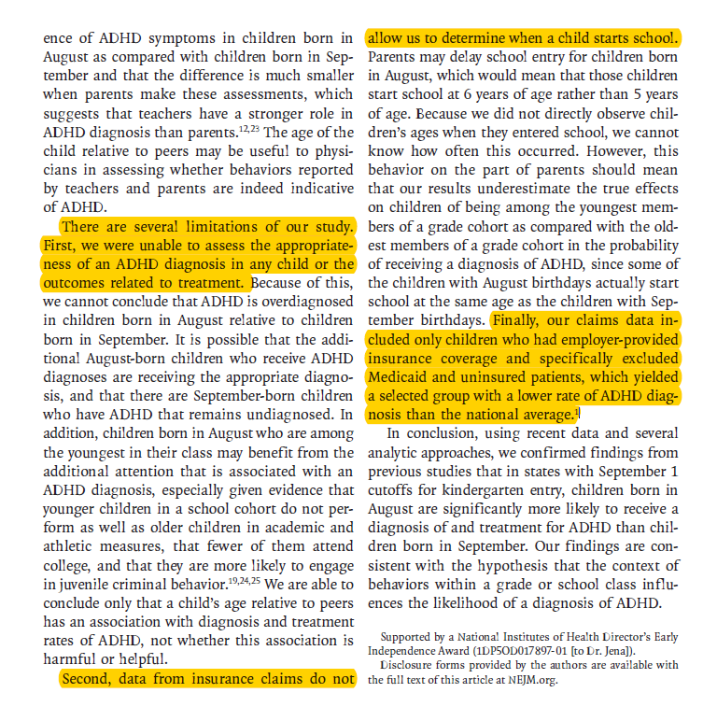
Looking at Uncertainty in Scientific Literature

Slide 22
Your Turn
http://bit.ly/uncertainLOEX

Slide 23
Bibliography
Boykoff, M.T., & Boykoff, J.M. (2007). Climate change and journalistic norms: A case-study of US mass-media coverage. Geoforum, 38(6), 1190-1204. https://doi.org/10.1016/j.geoforum.2007.01.008
Douglas, K. M., Sutton, R. M., & Cichocka, A. (2017). The Psychology of Conspiracy Theories. Current Directions in Psychological Science, 26(6), 538-542. https://doi.org/10.1177/0963721417718261
Drummond, C., & Fischhoff, B. (2017). Individuals with greater science literacy and education have more polarized beliefs on controversial science topics. Proceedings of the National Academy of Sciences of the United States of America, 114(36), 9587-9592. https://doi.org/10.1073/pnas.1704882114
Dugas, M. J., Hedayati, M., Karavidas, A., Buhr, K., Francis, K., & Phillips, N. A. (2005). Intolerance of uncertainty and information processing: Evidence of biased recall and interpretations. Cognitive Therapy and Research, 29(1), 57-70. https://doi.org/0.1007/s10608-005-1648-9
Firestein, S. (2012). Ignorance: How it drives science. New York: Oxford University Press.
Gallagher, B. & K. Berger (2019, Feb 14) Why Misinformation is about Who You Trust, Not What You Think. Nautilus, 69. Retrieved from http://nautil.us/issue/69/patterns/why-misinformation-is-about-who-you-trust-not-what-you-think.
Han, P. K. J., Zikmund-Fisher, B. J., Duarte, C. W., Knaus, M., Black, A., Scherer, A. M., & Fagerlin, A. (2018). Communication of scientific uncertainty about a novel pandemic health threat: Ambiguity aversion and its mechanisms. Journal of Health Communication, 23(5), 435-444. https://doi.org/10.1080/10810730.2018.1461961
Hanna-Attisha, M. (2018) What the eyes don’t see: A story of crisis, resistance, and hope in an American city. One World: New York, NY.

Slide 24
Bibliography, continued
Houtman, E. (2015). “Mind-blowing”: Fostering self-regulated learning in information literacy instruction. Communications in Information Literacy 9(1), 7-18. https://doi.org/10.15760/comminfolit.2015.9.1.178
Kuhn, D., Cheney, R., & Weinstock, M. (2000). The development of epistemological understanding. Cognitive Development 15, 309–328. https://doi.org/10.1016/S0885-2014(00)00030-7
Lenker, M. (2017). Developmentalism: Learning as the Basis for Evaluating Information. Portal: Libraries and the Academy 17(4), 721-737. https://doi.org/10.1353/pla.2017.0043
Manz, Eve. (2018). Designing for and analyzing productive uncertainty in science investigations. In Kay, J. & Luckin, R. (Eds.), Rethinking Learning in the Digital Age: Making the Learning Sciences Count, 13th International Conference of the Learning Sciences Volume 1 (288-295). London, UK: International Society of the Learning Sciences.
Meriam Library (2010). Evaluating Information - Applying the CRAAP test [PDF file]. Retrieved from https://library.csuchico.edu/sites/default/files/craap-test.pdf
Perry, W. G. (1970). Forms of intellectual and ethical development in the college years: A scheme. New York: Holt, Rinehart and Winston.
Rabinovich, A. & Morton, T. A. (2012). Unquestioned answers or unanswered questions: beliefs about science guide responses to uncertainty in climate change risk communication. Risk Analysis, 32(6), 992-1002. https://doi.org/10.1111/j.1539-6924.2012.01771.x

Slide 25
Image Credits
Slide 2
Chana via MSU Libraries (photo by Katie Diamond)
Slide 5
Newton via Wikimedia Commons (Public Domain)
Spacetime lattice analogy via Wikimedia Commons (user Mysid)
Slide 7
Screenshot of Breaking News Handbook PDF
Slide 12
Cigarette ad via Wikimedia Commons (Public Domain)
Lucky Strike via Wikimedia Commons (user Ms3qz)
Slide 13
Thule recycles scrap metal via US Air Force
Slide 18
Price, E. (2018). Obesity can spread like the flu between friends and neighbors. Retrieved from http://fortune.com/2018/01/24/obesity-spread-flu/ (screenshot, Emilia Marcyk, modified headline also by Emilia Marcyk)
Slides 19-21
Layton, T. J., Barnett, M. L., Hicks, T. R., & Jena, A. B. (2018). Attention Deficit–Hyperactivity Disorder and Month of School Enrollment. New England Journal of Medicine, 379(22), 2122-2130. doi:10.1056/NEJMoa1806828. (Screenshot, Chana Kraus-Friedberg).
All other images by Emilia Marcyk

Slide 26
QUESTIONS?
Group Document http://bit.ly/uncertainLOEX
Emilia Marcyk
marcyk@msu.edu
@ermthebookworm
Chana Kraus-Friedberg
krausfri@msu.edu

